Slide 1

GenomePro 2.0
Guido Ruiz – Backend Developer
Mardoqueu Mesquita – Frontend Developer
Michael Robinson – Product Owner

Slide 2

Problem Definition
Genomic Data Processing: Biomedical Researchers struggle as they perform the necessary steps to find patterns within their genomic data using programs such as Excel to perform arithmetic calculations on extensively large data files
Many concerns arose from this issue because genome data files need to be first cleaned up, i.e. remove any garbage from the files.

Slide 3
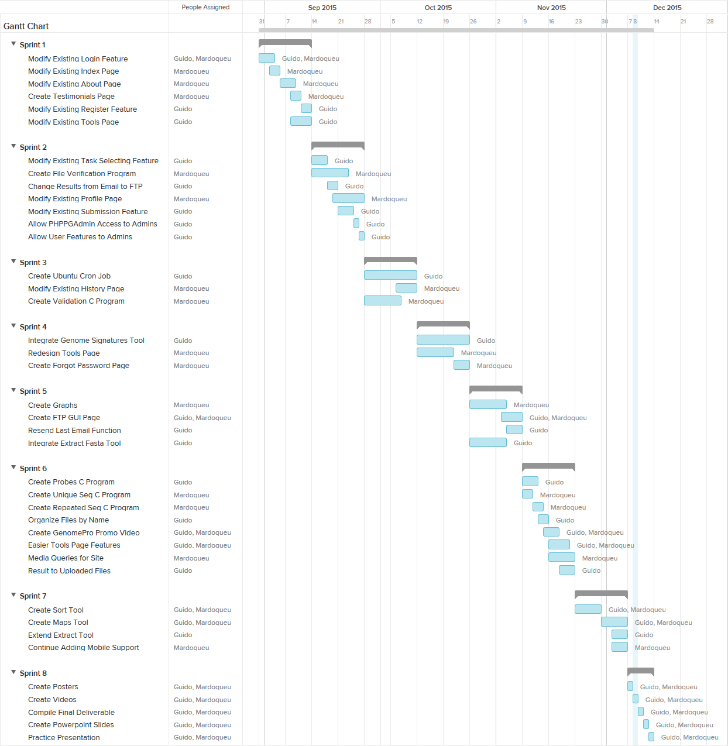
Gantt Chart

Slide 4
User Stories
User Story # 231– Modify Existing Forgot Password Feature
Priority: Required
Description:
As a user, I want to login in using a more intuitive way that does not obstruct other components of the website.
User Story # 232 – Modify Existing Register Page
Priority: Required
Description:
As a user, I want to register in a better, more intuitive way.
User Story # 233 – Modify Existing Login Feature
Priority: Required
Description:
As a user, I want to login in using a more intuitive way that does not obstruct other components of the website.
User Story # 234 – Modify Existing Submission Feature
Priority: Required
Description:
As a user, I want to be able to submit my sample data (in this case DNA) into the system in a secure way, so that I can use such data for other features of the site.
User Story # 235 – Change results from Email to FTP
Priority: Required
Description:
As a user, I want any results of my experiments with data to be sent to me in form of an FTP server, so that I can view the results in an effective way that can deal with very large result sets.

Slide 5
User Stories
User Story # 236 – Modify Existing Task Selecting Feature
Priority: Required
Description:
As a user, I want to be able to select which task I wish to do with my DNA, so that I can get results tailored to me and not have to pass my data through all possible tasks.
User Story #237 – Modify Existing About Page
Priority: Required
Description:
As a user, I want to be able to view what GenomePro is all about in a more intuitive way than it currently is, so that I don’t have to spend too much time figuring out what functions it can offer me.
User Story # 238 – Modify Existing Profile Page
Priority: Required
Description:
As a user, I want to create my profile in a more unique way, so that the GenomePro site can tailor my unique experience and so that administrators of the site know more about the kind of person performing tasks on DNA.
User Story # 239 – Modify Existing Home Page
Priority: Required
Description:
As a user, I want the main page of GenomePro to be descriptive enough for me to understand what GenomePro is about in a nutshell, and must also offer basic functionalities of a site, so that I am not turned down by the authenticity of the system.
User Story # 241 – Allow PHPMYADMIN Access to Administrators
Priority: Required
Description:
As an administrator, I want to be able to access the PHPMyAdmin site, so that I can modify the database and monitor my users.

Slide 6
User Stories
User Story # 242 – Allow User Features to Administrators
Priority: Required
Description:
As an administrator, I want access to regular user features like uploading DNA so that I can also perform tasks on DNA.
User Story # 243 – Modify Existing Tools Page
Priority: Required
Description:
As a user I want to be able to upload and delete files to/from my database so I can manage what to do with those files.
User Story # 244 - Create File Verification Program
Priority: Required
Description:
As a user, I want the system to verify my files uploaded are verified, so that any tools I run on them can succeed.
User Story # 245 – Create FTP GUI Page
Priority: Required
Description:
As a user, I want to see my files in a user interface to view them and delete them. This includes both the files I upload and my result files. This is so that I have control over what GenomePro has access to AND to view my results in an FTP page.

Slide 7
User Stories
User Story # 246 - Create Ubuntu Server CRON Jobs
Priority: Required
Description:
As a user, I want my jobs processed in a ‘first come, first serve’ order and without me being present, so that I may log in whenever I want to check the status of all the jobs I’ve submitted.
User Story # 247 - Create Validation C Program
Priority: Required
Description:
As a user, I want the system to verify my uploaded files so that I know if they’re DNA, RNA, etc. or invalid.
User Story # 248 – Modify Existing History Page
Priority: Required
Description:
As a user, I want to see my results listed in a table format for better where I can sort them by order of job id or submission date, so that I can easily search for results of my job submissions
User Story # 249 – Integrate Genome Signatures Functionality Tool
Priority: Required
Description:
As a user I want to be able to run a tool that find differences between each genome file so that I can better analyze them.

Slide 8
User Stories
User Story # 250 – Redesign Tools Page
Priority: Required
Description:
As a user I want to be able to identify all my files by type, so that I can correctly submit a job with specific requirements.
User Story # 251 – Create Forgot Password Functionality
Priority: Required
Description:
As a user I want to be able to submit a “forgot password” request and receive a temporary password via email so that I may have access to my account.
User Story # 252 – Resend Last Email Function
Priority: Required
Description:
As a user, if I do not receive an email from GenomePro registration and/or update email system, I should be able to have it resent to my current email. In other words. If I register but don’t receive a confirmation email, or if I change my email and don’t receive a confirmation email, I should be able to have GenomePro team resend me that email confirmation.
User Story # 253 – Integrate Fasta Sub-Sequence Tool
Priority: Required
Description:
As a user, I want to be able to extract sub-sequences of specific lengths with my files so that I can do further studies with that information.

Slide 9
User Stories
User Story # 254 – Create Graphs
Priority: Required
Description:
As a user, I want to see my data in both numerical and graphical representation so that I can better analyze patterns between sequences.
User Story # 258 – Create Probes C Program
Priority: Required
Description:
As a user, I want to be able to get information about my map files quickly using software that can batch produce results for me, so that I can find patterns within my genome data.
User Story # 259 – Create Unique Sequences C Program
Priority: Required
Description:
As a user, I want to be able to identify all unique sequences from a given map file, so that I can use that information to further develop patterns within my data.
User Story # 260 – Create Repeated Sequences Program
Priority: Required
Description:
As a user, I want to be able to identify all repeated sequences from a given map file as well as its number of repeats, so that I can use that information to further develop patterns within my data.
User Story # 261 – Organize Files by Name
Priority: Required
Description:
As a user, I want to see my files in both the tools page and FTP page to be sorted by time uploaded, so that can easily navigate through them from most recent to the oldest.

Slide 10
User Stories
User Story # 262 – Easier Tools Page Features
Priority: Required
Description:
As a user, I want to be able to see my files on double-clicking them and have map files separated from my DNA, RNA and Protein files so that I can submit jobs faster and not have to look too hard for specific files.
User Story # 263 – Result to Upload Files
Priority: Required
Description:
As a user, I want to able to use some of my result files as input files for other tools, so that I don’t have to download them and upload them again.
User Story # 264 – Media Queries For Website
Priority: Required
Description:
As a user, I want to be able to see the GenomePro website on different screen resolutions e.g. 1024 x 768 to 1920 x 1080 as well as on smaller mobile devices so that I can have access to my files and tools at anytime, anywhere, from the comfort of any device.
User Story # 265 – Create GenomePro Promo Video
Priority: Required
Description:
As a user, I want my extracted genome file to be sorted so that I can use it with other GenomePro tools or use it with my own proprietary tools.

Slide 11
User Stories
User Story # 266 – Create Sort Tool
Priority: Required
Description:
As a user, I want to have a video that describes and promotes the tools offered by GenomePro in an easy to follow format so that I can understand all of its features and promote GenomePro to my colleagues and friends.
User Story # 267 – Create Maps Tool
Priority: Required
Description:
As a user, I want to be able to produce a map files from a sorted files, so that I can use the mapped data to generate charts as well as to use as input for other tools.
User Story # 268 – Extend Extract Tool
Priority: Required
Description:
As a user, I want the extract tool to offer me different options so that I can also sort the result files it produces and/or sort and create maps from those files, so that I don’t have to redo job submissions.
User Story # 269 – Continue Adding Mobile Support
Priority: Required
Description:
As a user, I want to be able to have access to GenomePro using a tablet e.g. IPad, so that I can submit jobs from my mobile devices as well.

Slide 12
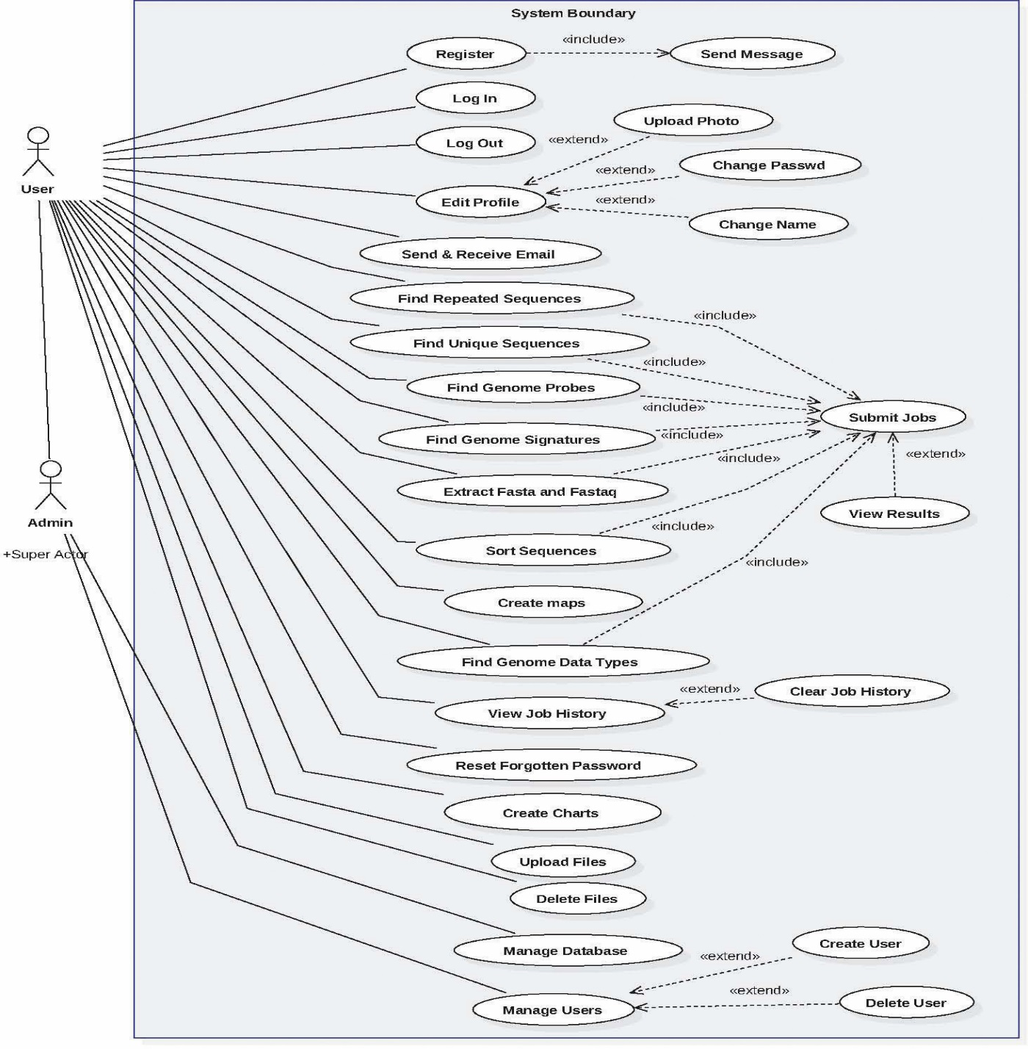
Use cases Implemented

Slide 13

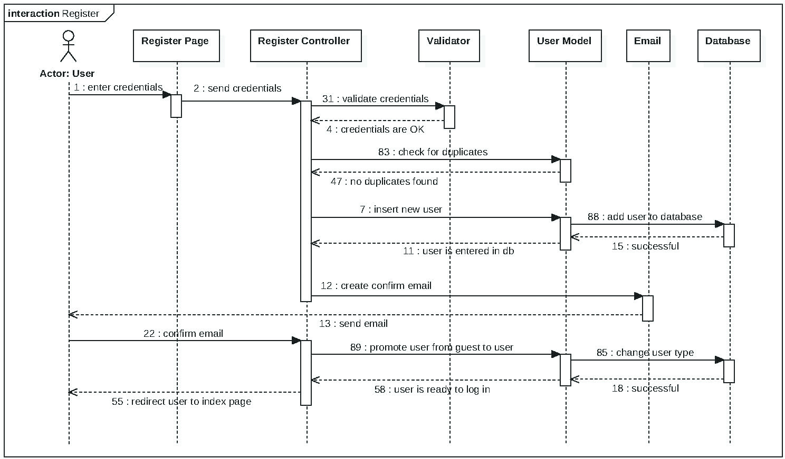
Register

Slide 14
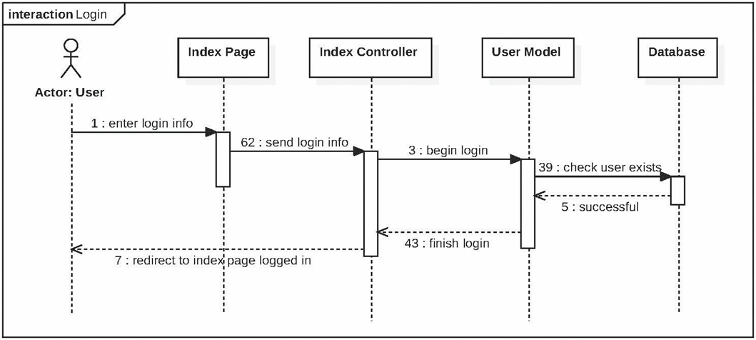
Login

Slide 15
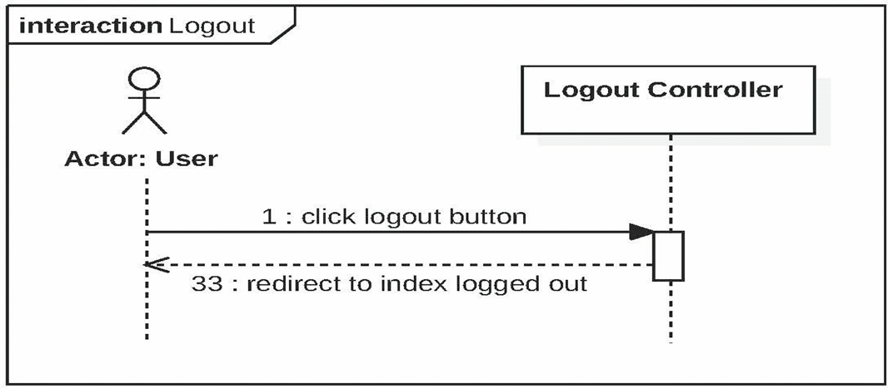
Logout

Slide 16
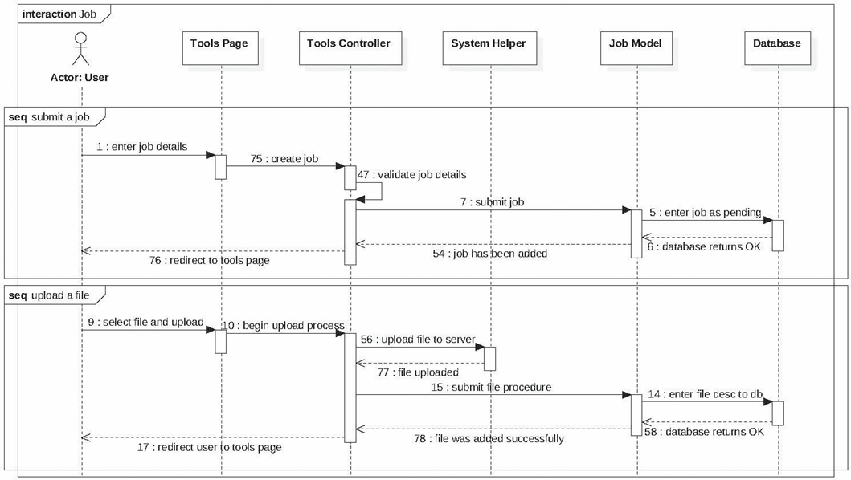
Submit Jobs

Slide 17
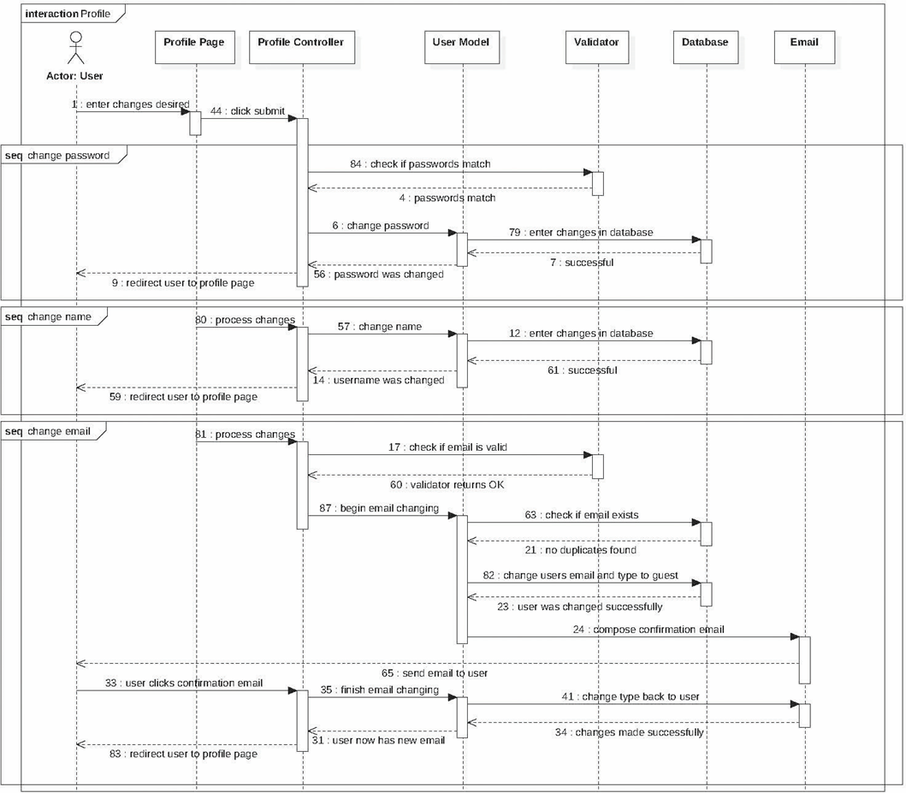
Profile

Slide 18
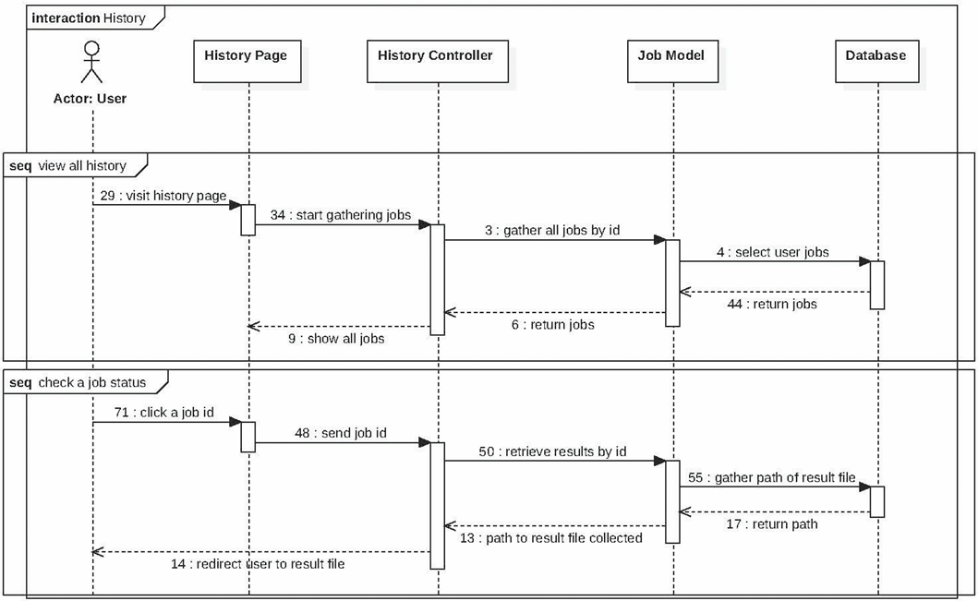
Job History

Slide 19
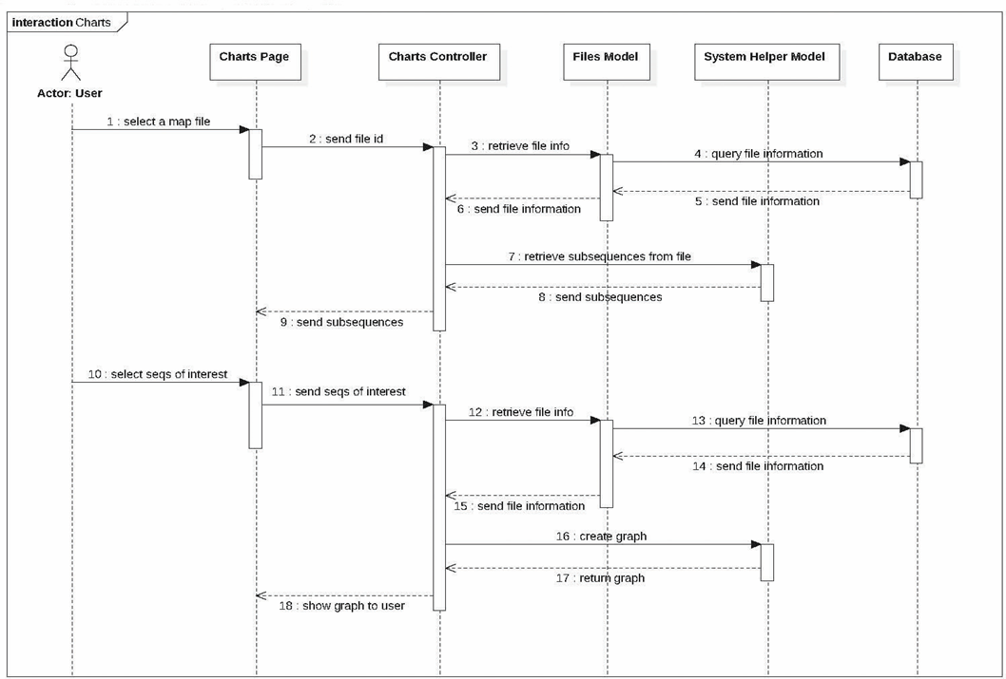
Create Charts

Slide 20
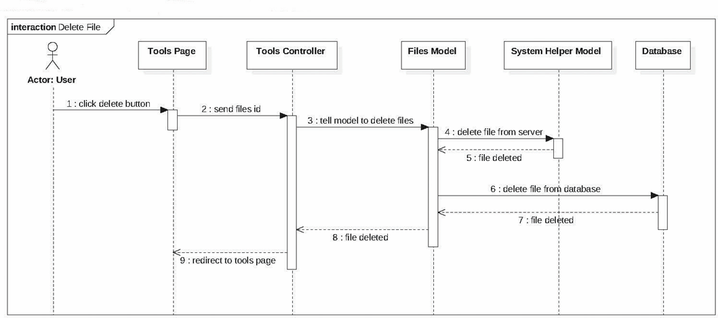
Delete Files

Slide 21
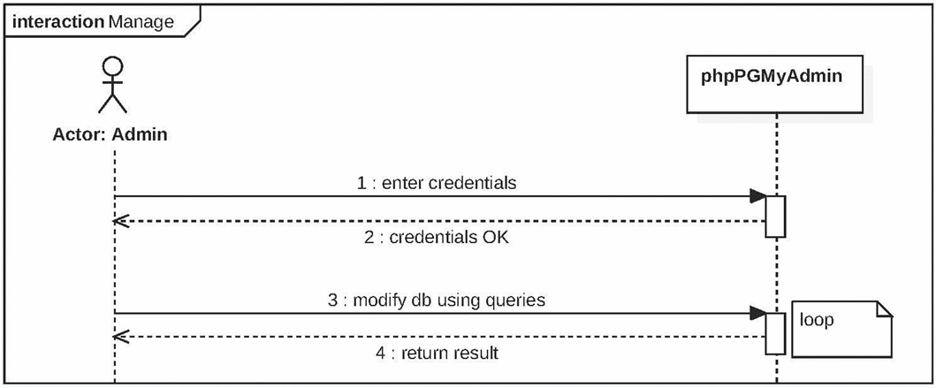
Manage (admin)

Slide 22
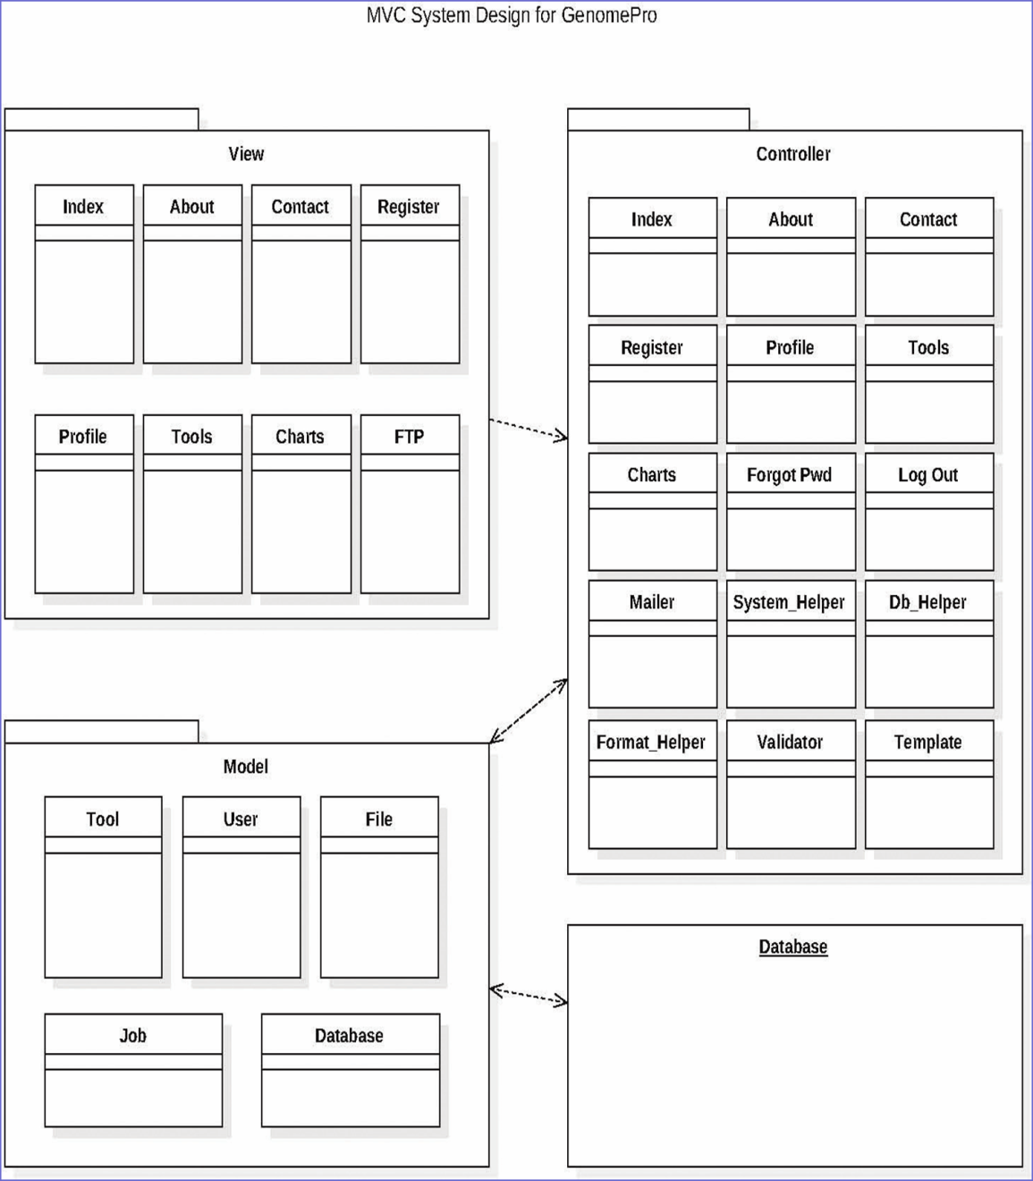
System Design and Decomposition
The system implementation was designed under the Model – View – Controller (MVC) as the primary architectural pattern for the GenomePro 2.0 system.
This architecture is appropriate for our system and we are glad to work with it. MVC emphasizes modularity and scalability thus allowing us to separate the application’s data, logic, and user interface
Under the MVC architecture, the system is split into 3 packages: the UI package, the Controller package, and the Data package

Slide 23
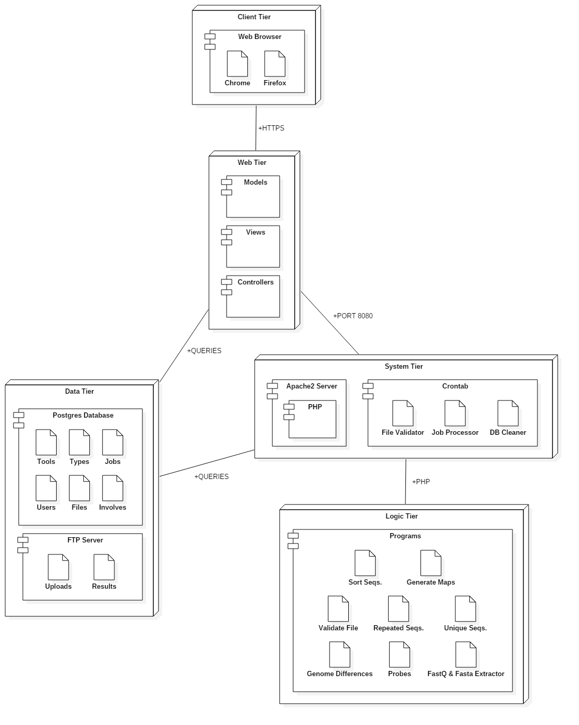
Deployment Diagram
GenomePro 2.0 is split into 5 tiers:
Client
Web
System
Logic
Data
The idea is to promote modularity and to limit communication between tiers therefore creating a more secure
and robust system architecture

Slide 24
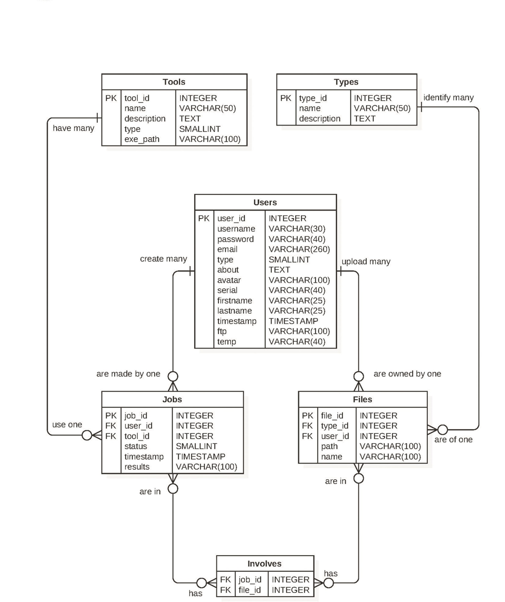
Database Modeling
Because GenomePro 2.0 offers several tools to Biomedical Researchers, and each tool handles files in a different manner, the need to build the database around the tools was evident.
There are currently 6 tables. Using joins, multiple information can be obtained from each user, ranging from personal information to job submission or file related information.
GenomePro 2.0 uses Postgres as its database and the schema is in third normal form.

Slide 25
Security
Prepared Statements
Database attacks are avoided using SQL prepared statements to verify any queries processed by Postgres.
All queries run through a database library that handles row retrieval and execution with the use of protected variables.
Automatic Logout
After a long period of inactivity, no actions are approved by the web service and the user is sent back to the login page
Pages there can only be accessed after logging in redirect guest users to the home page, preventing the use of GenomePro tools without account verification.
FTP Password Verification
Users are asked for their login information when accessing their FTP, even if they are logged into the site, to add another layer of security.

Slide 26
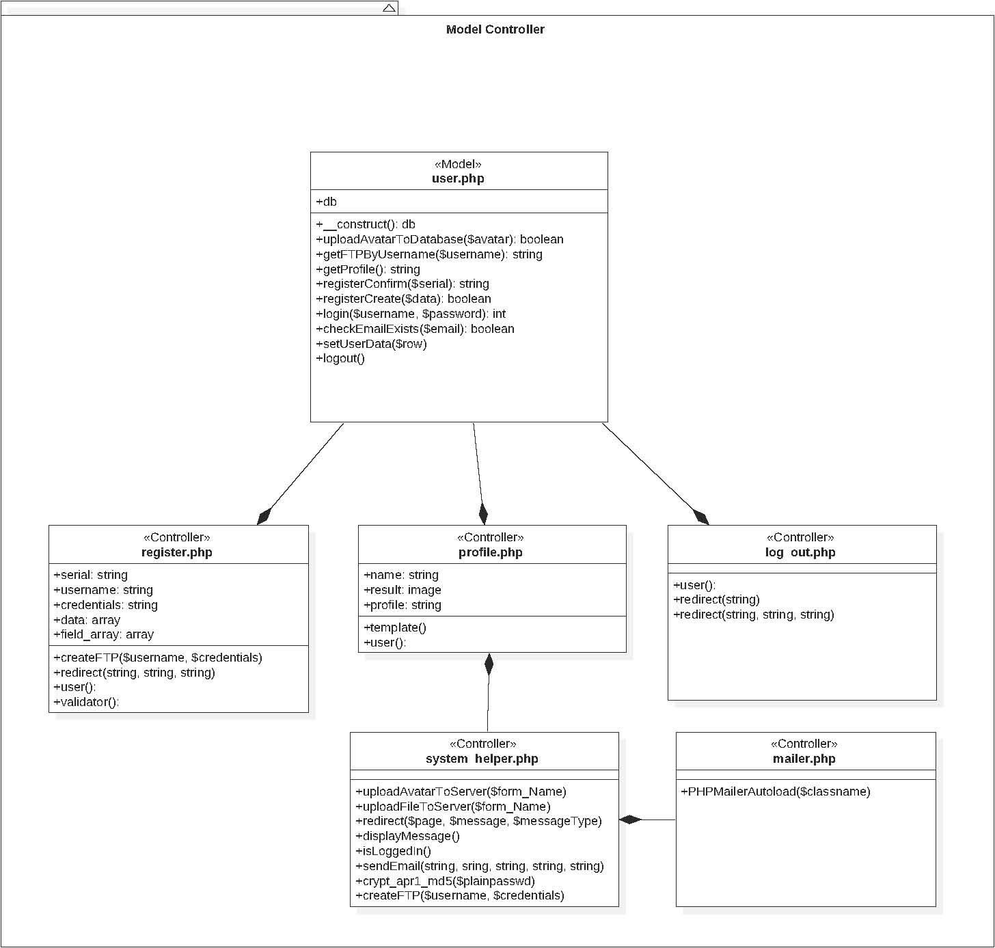
Model Controller

Slide 27
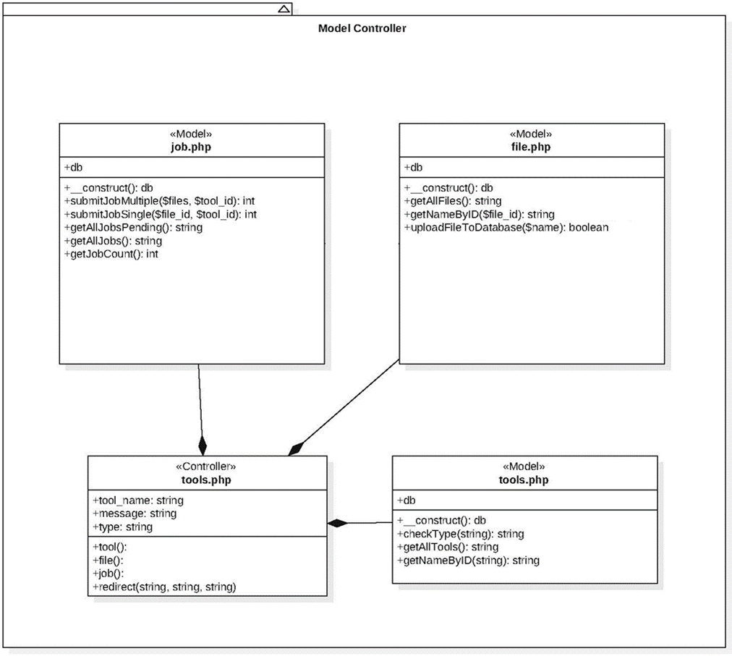
Model Controller

Slide 28
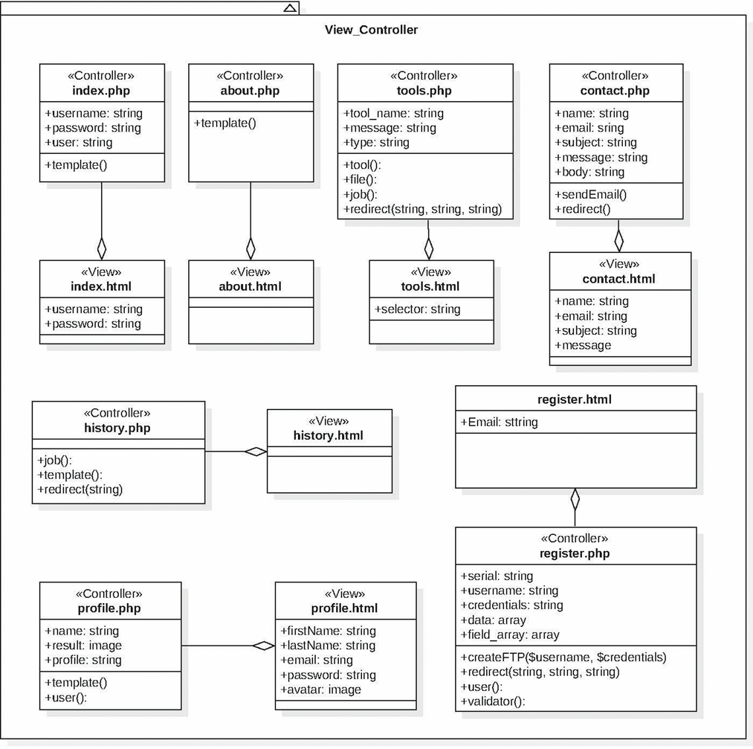
View Controller

Slide 29
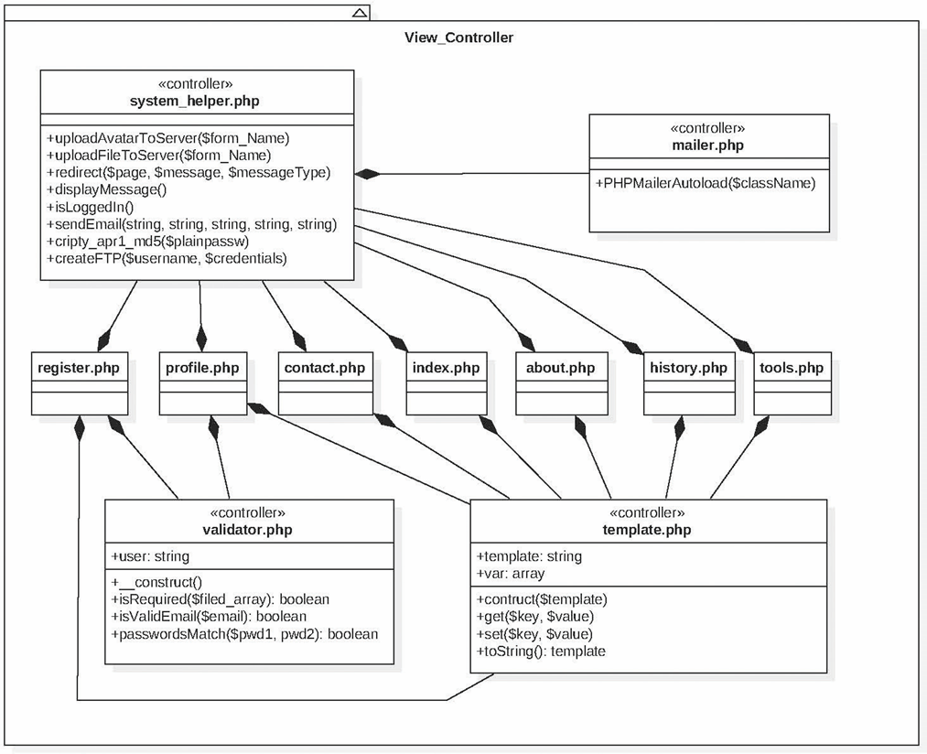
View Controller

Slide 30
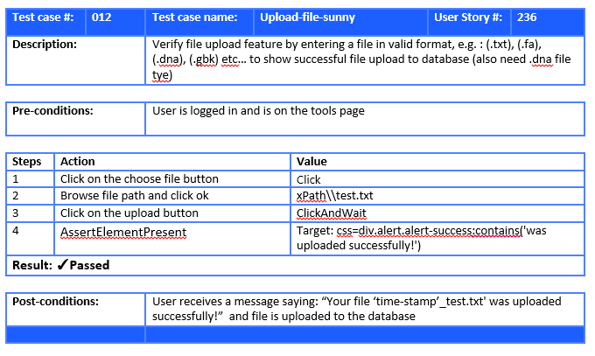
Verification

Slide 31
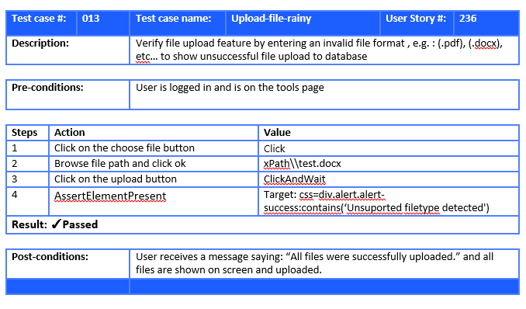
Verification

Slide 32
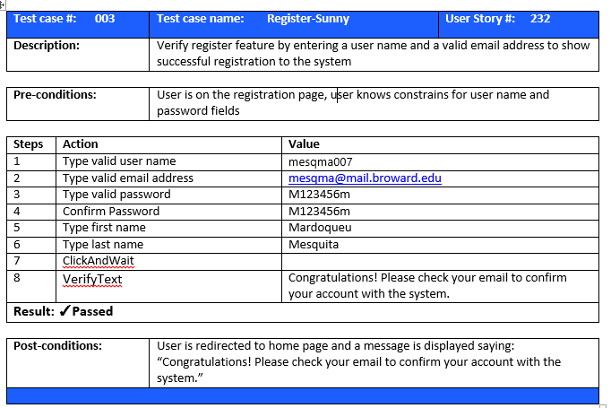
Verification

Slide 33
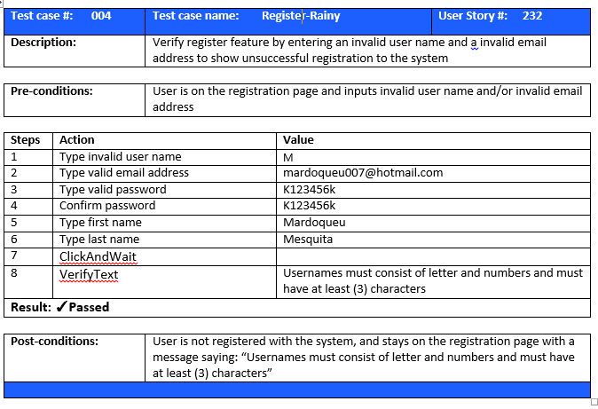
Verification

Slide 34
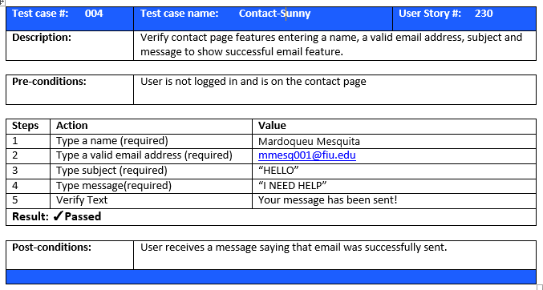
Verification

Slide 35
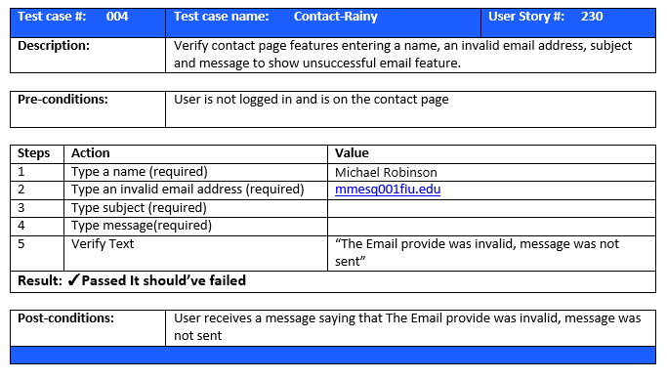
Verification

Slide 36
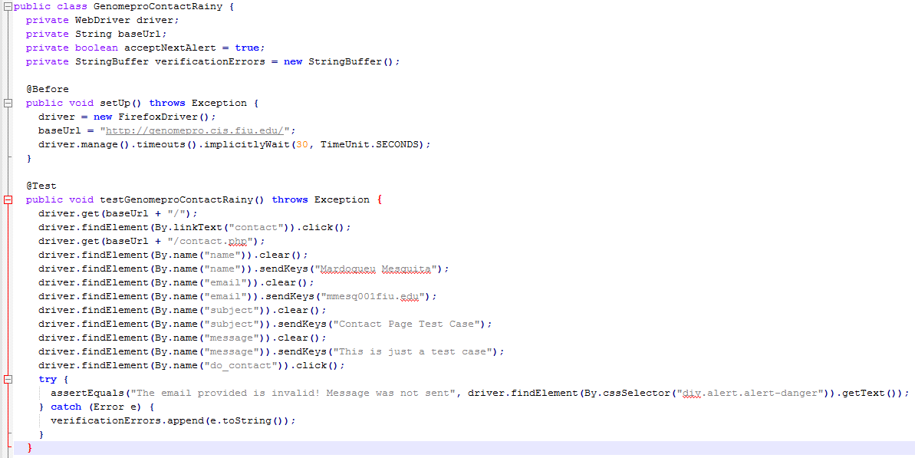
Test Scripts

Slide 37
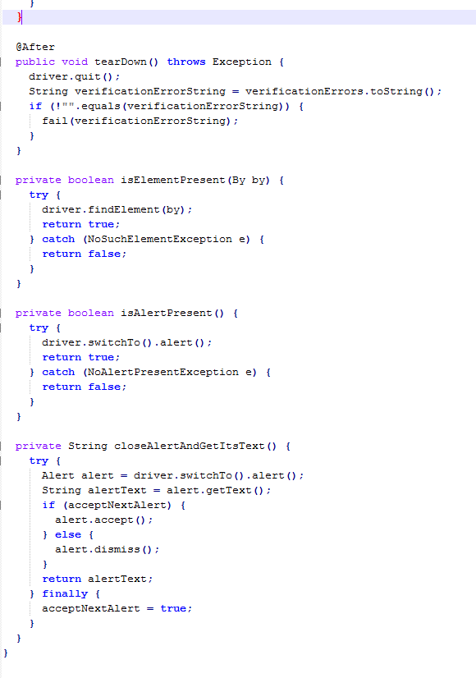
Test Scripts

Slide 38
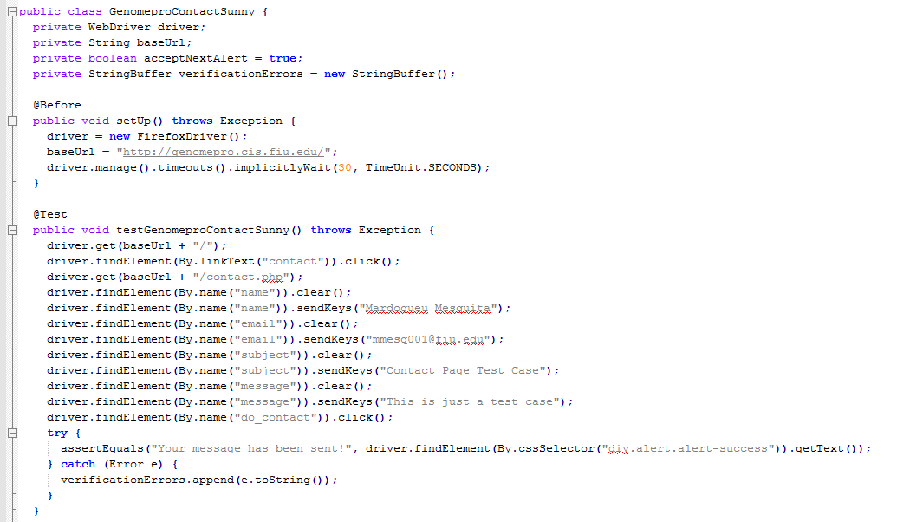
Test Scripts

Slide 39
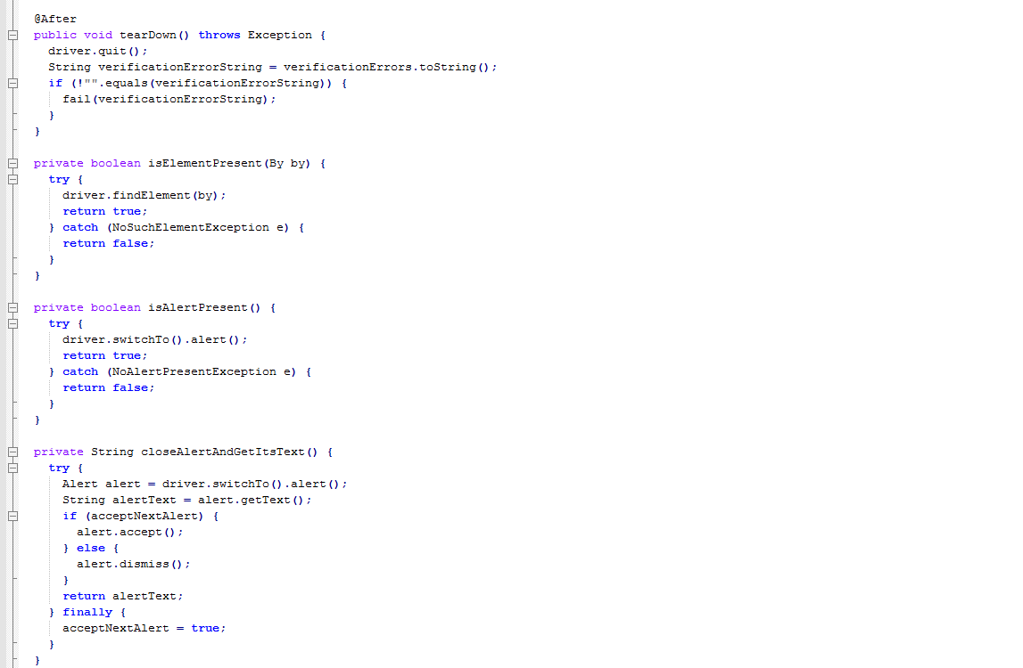
Test Scripts

Slide 40
THANK YOU!!
The GenomePro Team

